Slide 1
Complexity of conventional Sorting Algorithms
Course Code: CSC2211
Course Title: Algorithms
Dept. of Computer Science
Faculty of Science and Technology
Lecturer No: | 02 | Week No: | 02 | Semester: | Spring 22-23
Lecturer: | Md. Faruk Abdullah Al Sohan; faruk.sohan@aiub.edu

Slide 2
Lecture Outline
1. Sorting Algorithms
Merge Sort

Slide 3
Divide and Conquer
Recursive in structure
Divide the problem into independent sub-problems that are similar to the original but smaller in size
Conquer the sub-problems by solving them recursively. If they are small enough, just solve them in a straightforward manner. This can be done by reducing the problem until it reaches the base case, which is the solution.
Combine the solutions of the sub-problems to create a solution to the original problem

Slide 4
Merge Sort
Sorting Problem: Sort a sequence of n elements into non-decreasing order.
Divide: Divide the n-element sequence to be sorted into two subsequences of n/2 elements each
Conquer: Sort the two subsequences recursively using merge sort.
Combine: Merge the two sorted subsequences to produce the sorted answer.

Slide 5
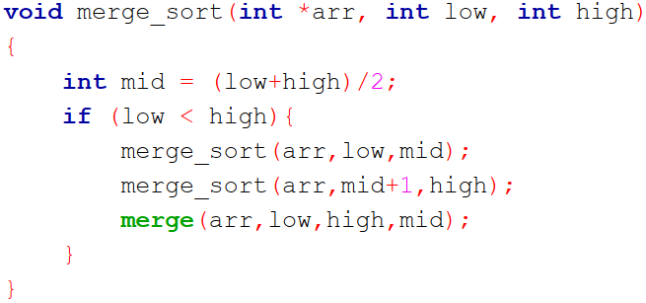
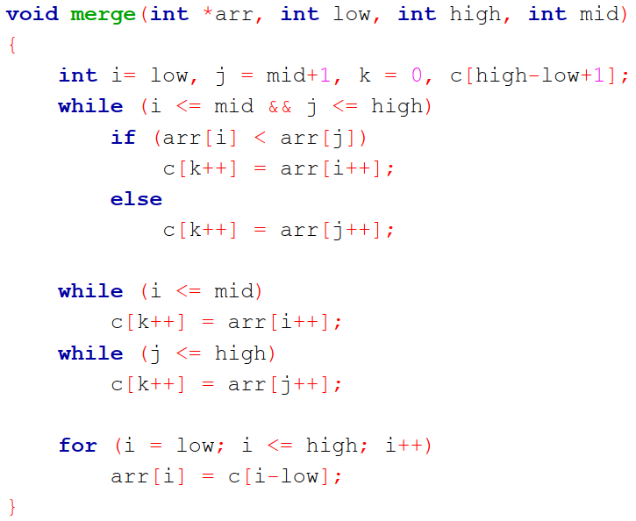
Merge Sort Algorithm
Step 1 − if it is only one element in the list it is already sorted, return.
Step 2 − divide the list recursively into two halves until it can no more be divided.
Step 3 − merge the smaller lists into new list in sorted order.

Slide 6
Merge Sort Algorithm
Merge(L,R,A) {
nL = length(L)
nR = length(R)
i= j = k = 0
while(i< nL && j< nR) {
if(L[i] <= R[j]) {
A[k] = L[i]
i= i+1
}
else {
A[k] = R[j]
j= j+1
}
k= k+1
}
while( i<nL) {
A[k] = L[i]; i=i+1; k=k+1;
}
while (j<nR) {
A[k] = R[i]; j=j+1; k=k+1;
}
}
Mergesort(A)
{
n = length(A)
if(n<2)
return
mid = n/2
L = array of size(mid)
R = array of size(n-mid)
for(i=0; i < mid; i++)
L[i] = A[i]
for(i=mid; i < n; i++)
R[i-mid] = A[i]
Mergesort(L)
Mergesort(R)
Merge(L , R , A)
}

Slide 7
Execution Example
Partition
7 2 9 4 ⏐ 3 8 6 1
7
Notes:
7

Slide 8
Execution Example (cont.)
Recursive call, partition
7 2 9 4 ⏐ 3 8 6 1
7 2 ⏐ 9 4
8
Notes:
8

Slide 9
Execution Example (cont.)
Recursive call, partition
7 2 9 4 ⏐ 3 8 6 1
7 2 ⏐ 9 4
7 ⏐ 2
9

Slide 10
Execution Example (cont.)
Recursive call, base case
7 2 9 4 ⏐ 3 8 6 1
7 2 ⏐ 9 4
7 ⏐ 2
7 → 7
10

Slide 11
Execution Example (cont.)
Recursive call, base case
7 2 9 4 ⏐ 3 8 6 1
7 2 ⏐ 9 4
7 ⏐ 2
7 → 7
2 → 2
11

Slide 12
Execution Example (cont.)
Merge
7 2 9 4 ⏐ 3 8 6 1
7 2 ⏐ 9 4
7 ⏐ 2 → 2 7
7 → 7
2 → 2
12

Slide 13
Execution Example (cont.)
Recursive call, …, base case, merge
7 2 9 4 ⏐ 3 8 6 1
7 2 ⏐ 9 4
7 ⏐ 2 → 2 7
9 4 → 4 9
7 → 7
2 → 2
9 → 9
4 → 4
13

Slide 14
Execution Example (cont.)
Merge
7 2 9 4 ⏐ 3 8 6 1
7 2 ⏐ 9 4 → 2 4 7 9
7 ⏐ 2 → 2 7
9 4 → 4 9
7 → 7
2 → 2
9 → 9
4 → 4
14

Slide 15
Execution Example (cont.)
Recursive call, …, merge, merge
7 2 9 4 ⏐ 3 8 6 1
7 2 ⏐ 9 4 → 2 4 7 9
3 8 6 1 → 1 3 6 8
7 ⏐ 2 → 2 7
9 4 → 4 9
3 8 → 3 8
6 1 → 1 6
7 → 7
2 → 2
9 → 9
4 → 4
3 → 3
8 → 8
6 → 6
1 → 1
15

Slide 16
Execution Example (cont.)
Merge
7 2 9 4 ⏐ 3 8 6 1 → 1 2 3 4 6 7 8 9
7 2 ⏐ 9 4 → 2 4 7 9
3 8 6 1 → 1 3 6 8
7 ⏐ 2 → 2 7
9 4 → 4 9
3 8 → 3 8
6 1 → 1 6
7 → 7
2 → 2
9 → 9
4 → 4
3 → 3
8 → 8
6 → 6
1 → 1
16

Slide 17
7 2 9 4 ⏐ 3 8 6 1 → 1 2 3 4 6 7 8 9
7 2 ⏐ 9 4 → 2 4 7 9
3 8 6 1 → 1 3 6 8
7 ⏐ 2 → 2 7
9 4 → 4 9
3 8 → 3 8
6 1 → 1 6
7 → 7
2 → 2
9 → 9
4 → 4
3 → 3
8 → 8
6 → 6
1 → 1
17

Slide 18
Merge(L,R,A) {
nL = length(L)
nR = length(R)
i= j = k = 0
while(i< nL && j< nR) {
if(L[i] <= R[j]) {
A[k] = L[i]
i= i+1
}
else {
A[k] = R[j]
j= j+1
}
k= k+1
}
while( i<nL) {
A[k] = L[i]; i=i+1; k=k+1;
}
while (j<nR) {
A[k] = R[i]; j=j+1; k=k+1;
}
}
n*c0+ n*c1+n*c2+ c4
=n*(c0+c1+c2) + c4
=n*c3 + c4
=n (Linear time)
Because of having no nested loops

Slide 19
nL = length(L)
nR = length(R)
i= j = k = 0
i=0
j=0
L
14
23
45
98
R
6
33
42
67

Slide 20
while(i< nL && j< nR) {
If(L[i] <= R[j]) {
A[k] = L[i]
i= i+1
}
else {
A[k] = R[j]
j= j+1
}
k= k+1
}
i=0
j=0
L
14
23
45
98
R
6
33
42
67
A

Slide 21
while(i< nL && j< nR) {
If(L[i] <= R[j]) {
A[k] = L[i]
i= i+1
}
else {
A[k] = R[j]
j= j+1
}
k= k+1
}
i=0
j=1
L
14
23
45
98
R
6
33
42
67
A
6
k=0

Slide 22
while(i< nL && j< nR) {
If(L[i] <= R[j]) {
A[k] = L[i]
i= i+1
}
else {
A[k] = R[j]
j= j+1
}
k= k+1
}
i=1
j=1
L
14
23
45
98
R
6
33
42
67
A
6
14
k=1

Slide 23
while(i< nL && j< nR) {
If(L[i] <= R[j]) {
A[k] = L[i]
i= i+1
}
else {
A[k] = R[j]
j= j+1
}
k= k+1
}
i=2
j=1
L
14
23
45
98
R
6
33
42
67
A
6
14
23
k=2

Slide 24
while(i< nL && j< nR) {
If(L[i] <= R[j]) {
A[k] = L[i]
i= i+1;
}
else {
A[k] = R[j]
j= j+1
}
k= k+1
}
i=2
j=2
L
14
23
45
98
R
6
33
42
67
A
6
14
23
33
k=3

Slide 25
while(i< nL && j< nR) {
If(L[i] <= R[j]) {
A[k] = L[i]
i= i+1
}
else {
A[k] = R[j]
j= j+1
}
k= k+1
}
i=2
j=3
L
14
23
45
98
R
6
33
42
67
A
6
14
23
33
42
k=4

Slide 26
while(i< nL && j< nR) {
If(L[i] <= R[j]) {
A[k] = L[i]
i= i+1
}
else {
A[k] = R[j]
j= j+1
}
k= k+1
}
i=3
j=3
L
14
23
45
98
R
6
33
42
67
A
6
14
23
33
42
45
k=5

Slide 27
while(i< nL && j< nR) {
If(L[i] <= R[j]) {
A[k] = L[i]
i= i+1
}
else {
A[k] = R[j]
j= j+1
}
k= k+1
}
i=3
j=4
L
14
23
45
98
R
6
33
42
67
A
6
14
23
33
42
45
67
k=6

Slide 28
while(i< nL && j< nR) {
If(L[i] <= R[j]) {
A[k] = L[i]
i= i+1
}
else {
A[k] = R[j]
j= j+1
}
k= k+1
}
i=3
j=4
L
14
23
45
98
R
6
33
42
67
A
6
14
23
33
42
45
67
k=6

Slide 29
while( i<nL) {
A[k] = L[i];
i=i+1;
k=k+1;
}
while (j<nR) {
A[k] = R[i];
j=j+1;
k=k+1;
}
i=3
j=4
L
14
23
45
98
R
6
33
42
67
A
6
14
23
33
42
45
67
k=6

Slide 30
while( i<nL) {
A[k] = L[i];
i=i+1;
k=k+1;
}
while (j<nR) {
A[k] = R[i];
j=j+1;
k=k+1;
}
i=4
j=4
L
14
23
45
98
R
6
33
42
67
A
6
14
23
33
42
45
67
98
k=7

Slide 31
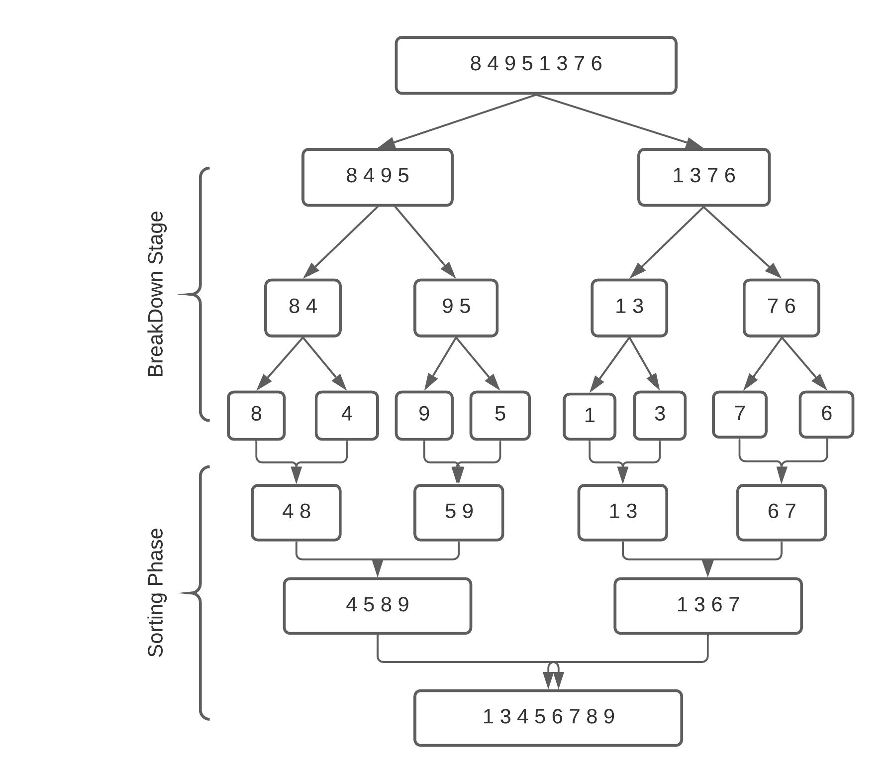

Slide 32
Exercise
98
23
45
14
6
67
33
42

Slide 33
Merge Sort Analysis
The divide step takes constant time, regardless of the subarray size. After all, the divide step just computes the midpoint q of the indices p and r. Recall that in big-O notation, we indicate constant time by O(1).
The conquer step, where we recursively sort two subarrays of approximately n/2 elements each, takes some amount of time, but we'll account for that time when we consider the subproblems.
The combine step merges a total of n elements, taking O(n) time.

Slide 34
Merge Sort Analysis
Substitution Method

Slide 35
Mergesort(A) { | T(n), to sort n elements
n = length(A) if(n<2) return mid = n/2 L = array of size(mid) R = array of size(n-mid) | c1
for(i=0; i < mid; i++) L[i] = A[i] for(i=mid; i < n; i++) R[i-mid] = A[i] | c2* (n/2) + c2* (n/2) =c2( n/2 + n/2) =c2 * n
Mergesort(L) | T(n/2)
Mergesort(R) | T(n/2)
Merge(L , R , A) | c3.n+c4
}
So, T(n) = O(1) when n = 1, and 2T(n/2) + (c2+c3)*n + (c1+c4) when n > 1

Slide 36
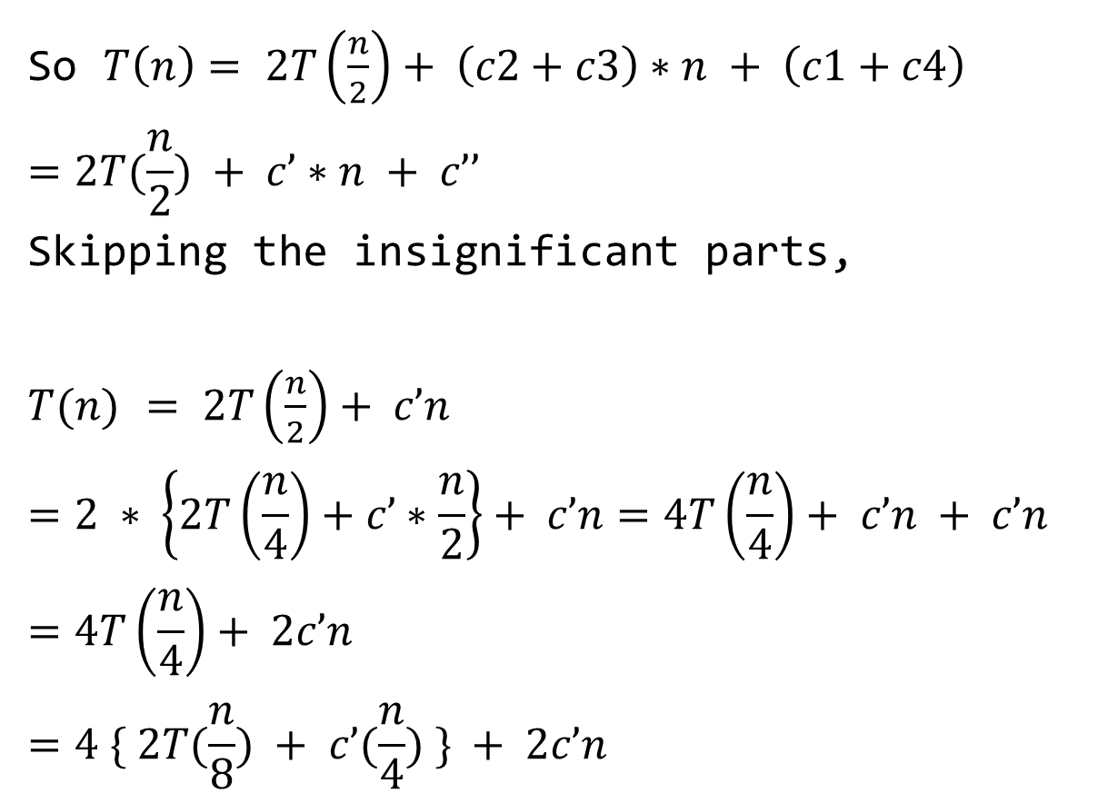
So $T\left(n\right)= 2T\left(\frac{n}{2}\right)+ \left(c2+c3\right)∗n + \left(c1+c4\right)$
$$=2T(\frac{n}{2}) + c’∗n + c’’$$
Skipping the insignificant parts,
$T(n)$ $= 2T\left(\frac{n}{2}\right)+ c’n$
$$=2 ∗ \left\{2T\left(\frac{n}{4}\right)+c’∗\frac{n}{2}\right\}+ c’n=4T\left(\frac{n}{4}\right)+ c’n + c’n$$
$$=4T\left(\frac{n}{4}\right)+ 2c’n$$
$$=4 \{ 2T(\frac{n}{8}) + c’(\frac{n}{4}) \} + 2c’n$$

Slide 37

$$= 8T(\frac{n}{8}) + 3c’n$$
$$= 8 \left\{ 2T\left(\frac{n}{16}\right)+ c’\left(\frac{n}{8}\right)\right\}+ 3c’n$$
$$= 16T(\frac{n}{16}) + 4c’n$$
$$= 2^{4} T \left(\frac{n}{2^{4}}\right)+4c^{′}n$$
$= 2^{k} T \left(\frac{n}{2^{k} }\right)+kc′n$ [$k=4$]
$$Let, \frac{n}{2^{k} } = 1$$
$2^{k} = n$
$k =\log{2}n$

Slide 38
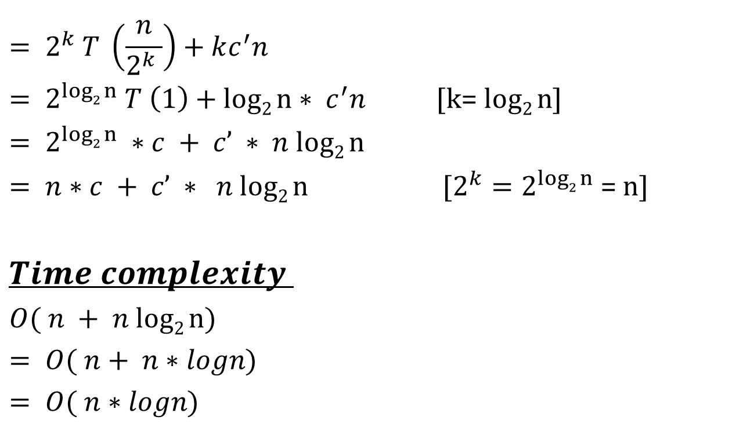
$$= 2^{k} T \left(\frac{n}{2^{k} }\right)+kc^{′}n$$
$= 2^{log2 n} T \left(1\right)+log2 n∗ c^{′}n$ [k= $log2 n$]
$$= 2^{log2 n} ∗c + c’ ∗ n log2 n$$
$= n∗c + c’ ∗ n log2 n$ [${2^{k}=2}^{log2 n}$= n]
$$Time complexity$$
$$O( n + n log2 n)$$
$$= O( n+ n∗logn)$$
$$= O( n∗logn)$$

Slide 39
Merge Sort Analysis
Recursion Tree Method

Slide 40
Recursion-tree Method
Show successive expansions of recurrences using trees.
Keep track of the time spent on the subproblems of a divide and conquer algorithm.
Help organize the algebraic bookkeeping necessary to solve a recurrence.

Slide 41
Recursion-tree Method for Merge Sort
For the original problem, we have a cost of cn, plus two subproblems each of size (n/2) and running time T(n/2).
Each of the size n/2 problems has a cost of cn/2 plus two subproblems, each costing T(n/4).
cn
cn
Cost of divide and merge.
cn/2
cn/2
T(n/2)
T(n/2)
T(n/4)
T(n/4)
T(n/4)
T(n/4)
Cost of sorting subproblems.

Slide 42
Recursion Tree for Merge Sort
Continue expanding until the problem size reduces to 1.
cn
Each level has total cost cn.
Each time we go down one level, the number of sub-problems doubles, but the cost per sub-problem halves ⇒ cost per level remains the same.
There are lg n + 1 levels, height is lg n. (Assuming n is a power of 2.)
Total cost = sum of costs at each level = (lg n + 1)cn = cnlgn + cn = O(n lgn).
cn/2
cn/2
cn/4
cn/4
cn/4
cn/4
c
c
c
c
c
c

Slide 43
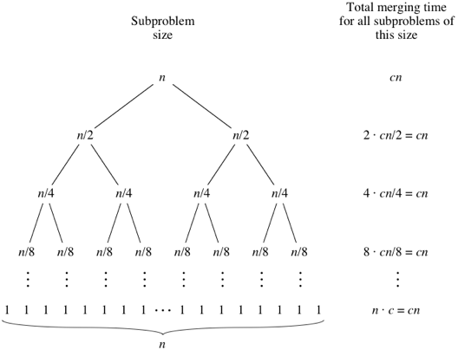
Recursion-tree Method for Merge Sort
Elements to sort /

Slide 44














Recursion Tree for Merge Sort
n
$$\frac{n}{2}$$
$$\frac{n}{2}$$
=c.n
$$\frac{n}{4}$$
$$\frac{n}{4}$$
$$\frac{n}{4}$$
$$\frac{n}{4}$$
=c.n
$$\frac{n}{8}$$
$$\frac{n}{8}$$
$$\frac{n}{8}$$
$$\frac{n}{8}$$
$$\frac{n}{8}$$
$$\frac{n}{8}$$
$$\frac{n}{8}$$
$$\frac{n}{8}$$
=c.n

Slide 45




























Recursion Tree for Merge Sort
n=8
n=8
$$\frac{n}{2}$$
$$\frac{n}{2}$$
$$\frac{n}{2}$$
c.n
$$\frac{n}{2}$$
$$\frac{n}{4}$$
$$\frac{n}{4}$$
=c.n
$$\frac{n}{4}$$
$$\frac{n}{4}$$
$$\frac{n}{4}$$
$$\frac{n}{4}$$
$$\frac{n}{4}$$
$$\frac{n}{4}$$
$$\frac{8}{8}$$
$$\frac{8}{8}$$
$$\frac{8}{8}$$
$$\frac{8}{8}$$
$$\frac{8}{8}$$
$$\frac{8}{8}$$
$$\frac{8}{8}$$
$$\frac{8}{8}$$
$\frac{8}{8}$=1
$\frac{8}{8}$=1
$\frac{8}{8}$=1
$\frac{8}{8}$=1
$\frac{8}{8}$=1
$\frac{8}{8}$=1
$\frac{8}{8}$=1
$\frac{8}{8}$=1
=c.n
Continue expanding until the problem size reduces to 1.
So , if n=8 we need 3cn

Slide 46
n=8 | 3 levels | we need 3.cn
n=16 | 4 levels | we need 4.cn
n=32 | 5 levels | we need 5.cn
n=64 | 6 levels | we need 6.cn

Slide 47
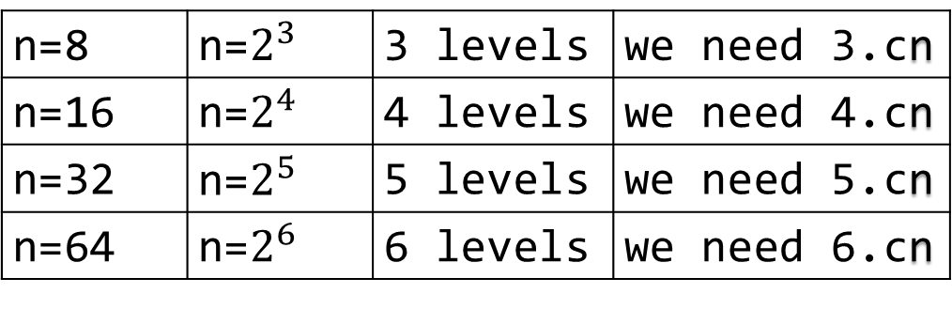
n=8 | n=$2^{3}$ | 3 levels | we need 3.cn
n=16 | n=$2^{4}$ | 4 levels | we need 4.cn
n=32 | n=$2^{5}$ | 5 levels | we need 5.cn
n=64 | n=$2^{6}$ | 6 levels | we need 6.cn

Slide 48
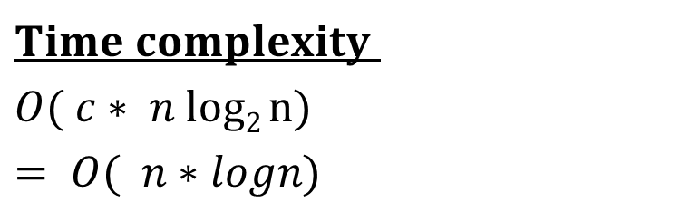
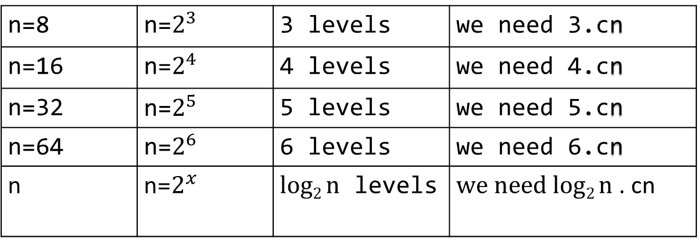
n=8 | n=$2^{3}$ | 3 levels | we need 3.cn
n=16 | n=$2^{4}$ | 4 levels | we need 4.cn
n=32 | n=$2^{5}$ | 5 levels | we need 5.cn
n=64 | n=$2^{6}$ | 6 levels | we need 6.cn
n | n=$2^{x}$ | $log2 n$ levels | $we need log2 n$ . cn
$$Time complexity$$
$$O( c∗ n log2 n)$$
$$= O( n∗logn)$$

Slide 49
Merge Sort Analysis
Master Method

Slide 50
The master method applies to recurrences of the form
T(n) = a T(n/b) + f (n) ,
where a ≥ 1, b > 1, and f is asymptotically positive.

Slide 51
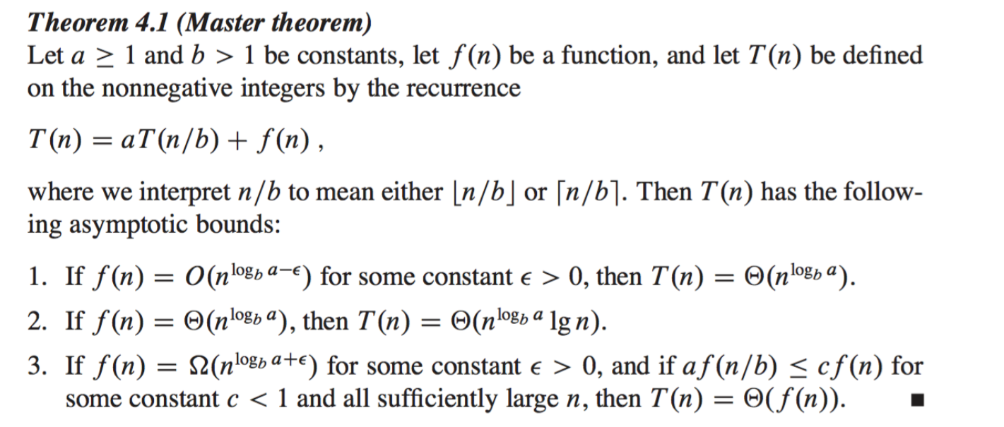

Slide 52
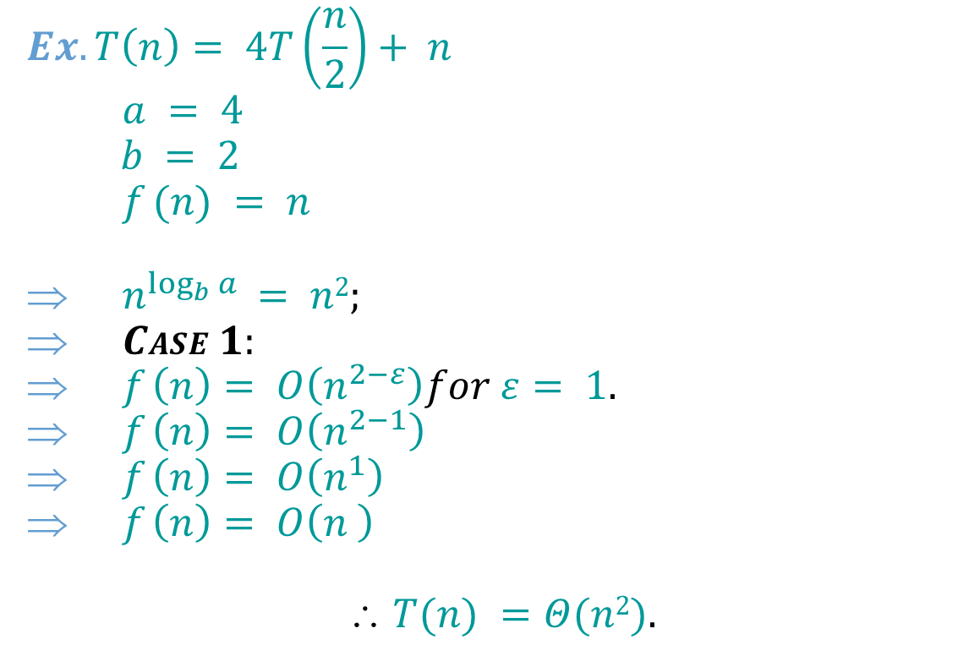
Examples:
$$Ex. T\left(n\right)= 4T\left(\frac{n}{2}\right)+ n$$
$$a = 4$$
$b = 2$
$$f (n) = n$$
$n^{\log_{b}{a}} = n2;$
$CASE 1:$
$f \left(n\right)= O\left(n^{2−ε}\right)for ε= 1.$
$f \left(n\right)= O\left(n^{2−1}\right)$
$f \left(n\right)= O\left(n^{1}\right)$
$f \left(n\right)= O\left(n^{ }\right)$
$$ T(n) =Θ(n2).$$

Slide 53

Examples:
$$Ex. T\left(n\right)= 4T\left(\frac{n}{2}\right)+ n^{2}$$
$$a = 4$$
$b = 2$
$$f (n) = n^{2}$$
$n^{\log_{b}{a}} = n2;$
$CASE 2:$
$f \left(n\right)= O\left(n^{2}\right).$
$$ T(n) =Θ(n2logn).$$

Slide 54

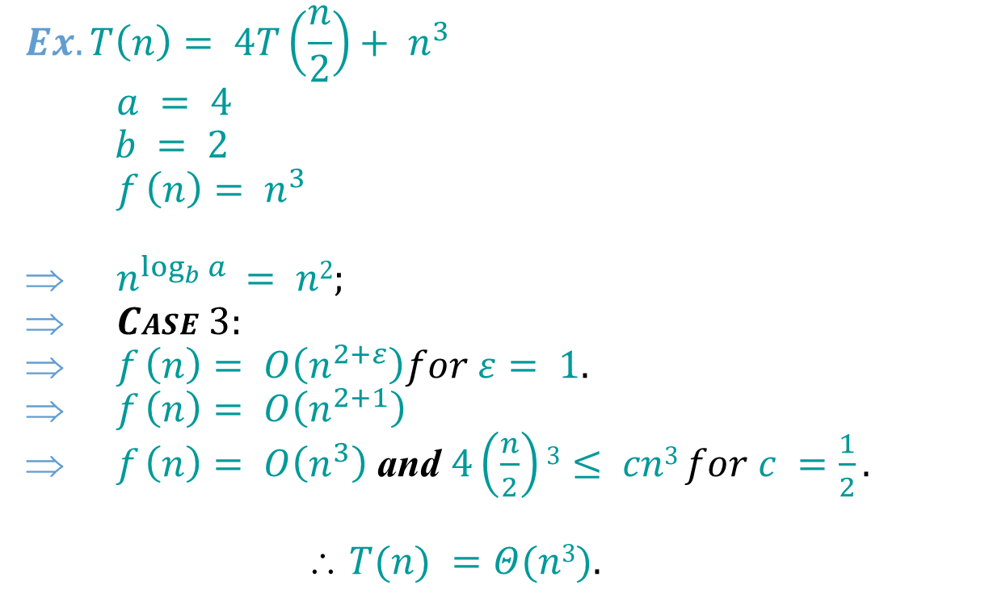
Examples:
$$Ex. T\left(n\right)= 4T\left(\frac{n}{2}\right)+ n^{3}$$
$$a = 4$$
$b = 2$
$$f \left(n\right)= n^{3}$$
$n^{\log_{b}{a}} = n2;$
$CASE 3:$
$f \left(n\right)= O\left(n^{2+ε}\right)for ε= 1.$
$f \left(n\right)= O\left(n^{2+1}\right)$
$f \left(n\right)= O\left(n^{3}\right)$ and $4\left(\frac{n}{2}\right)3≤ cn3 for c =\frac{1}{2}.$
$$ T(n) =Θ(n3).$$

Slide 55
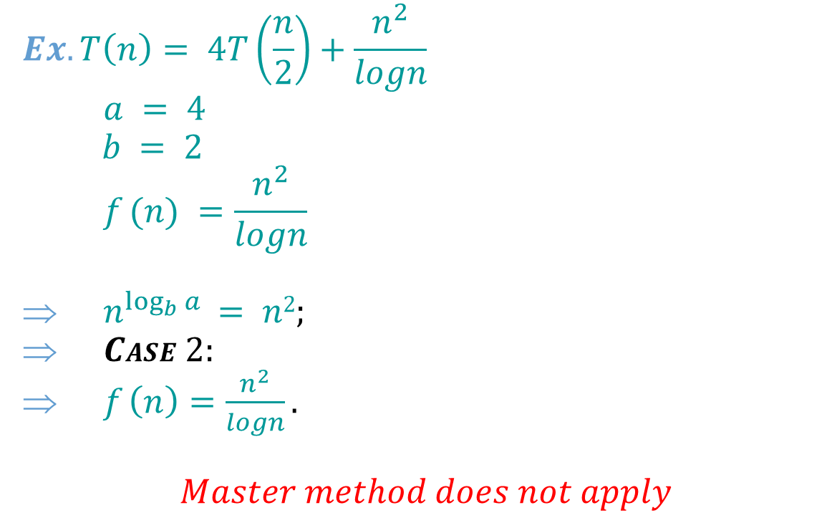
Examples:
$$Ex. T\left(n\right)= 4T\left(\frac{n}{2}\right)+\frac{n^{2}}{logn}$$
$$a = 4$$
$b = 2$
$$f (n) =\frac{n^{2}}{logn}$$
$n^{\log_{b}{a}} = n2;$
$CASE 2:$
$f \left(n\right)=\frac{n^{2}}{logn}.$
$$Master method does not apply$$

Slide 56
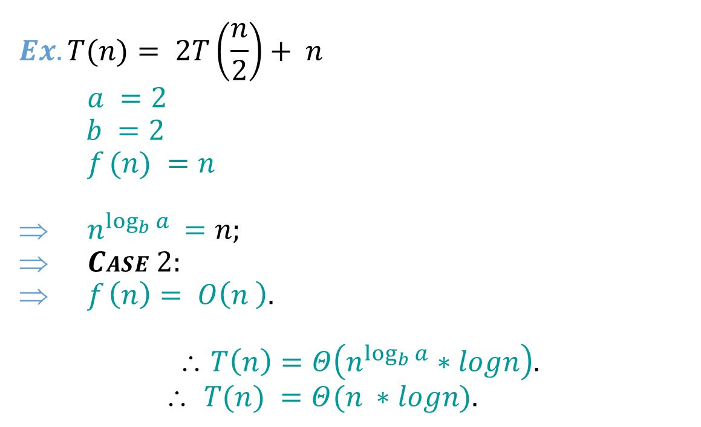
Examples:
$$Ex.T(n)= 2T\left(\frac{n}{2}\right)+ n$$
$$a =2$$
$b =2$
$$f (n) =n$$
$n^{\log_{b}{a}} =n;$
$CASE 2:$
$f \left(n\right)= O\left(n^{ }\right).$
$$ T\left(n\right)=Θ\left(n^{\log_{b}{a}}∗logn\right).$$
$$ T(n) =Θ(n^{ }∗logn).$$

Slide 57
Best Case Time Complexity: 𝛀(n*log n)
Worst Case Time Complexity: O(n*log n)
Average Time Complexity: ϴ(n*log n)
The time complexity of MergeSort is O(n*Log n) in all the 3 cases (worst, average and best) as the mergesort always divides the array into two halves and takes linear time to merge two halves.

Slide 58
Books
Introduction to Algorithms, Thomas H. Cormen, Charle E. Leiserson, Ronald L. Rivest, Clifford Stein (CLRS).
Fundamental of Computer Algorithms, Ellis Horowitz, Sartaj Sahni, Sanguthevar Rajasekaran (HSR)

Slide 59
References
https://www.google.com/search?q=bubble+sort+step+by+step&sxsrf=ALeKk01uxzgfT3Oy6k1Q3WxVnSpiIN8_4g:1587999728942&tbm=isch&source=iu&ictx=1&fir=vRwFsGwVfJ6pJM%253A%252CSzhhze6MPQr4cM%252C_&vet=1&usg=AI4_-kSrEEXqwRL-PkHhVUtn7jNfF9dB6g&sa=X&ved=2ahUKEwje0Pz974jpAhXRAnIKHWhMD2UQ_h0wAXoECAcQBg#imgrc=EN4Sdu7veOWVoM&imgdii=eOqvCu85p9-eBM
https://www.interviewcake.com/concept/java/counting-sort
https://www.geeksforgeeks.org/counting-sort/
https://www.hackerearth.com/practice/algorithms/sorting/quick-sort/tutorial/

